Slide 1

Marketing Analytics Case Analysis
Presented by: Ranjabati Chowdhury

Slide 2

TOPIC: Robinhood
Analysis of the Impact on Gamestop from the Gamestop Opportunistic Episode

Slide 3

Company overview
GameStop is an American retailer store that sells video games, hardware and accessories, software, and collectibles. The company's headquarters are located in Grapevine, Texas. Founded in 1996, the company is a leading specialized retailer in the gaming market, offering a wide range of entertaining gaming products through e-commerce and physical stores.
Around 2010, the company saw a decline due to a shift of video game sales to online shopping and downloads. The share price has been maintained at $3-4 from 2019 to 2020. With steadily falling share prices, GameStop closed a large number of brick-and-mortar stores, and Covid-19 accelerated
GameStop's fading [4]. However, just in January and February of 2021, as the main character in a well-orchestrated short squeeze scheme, GameStop's stock price has soared. According to a statement by Cohen, a shareholder of GameStop, on January 13, 2021, GameStop's share price rose 68.82%. During this period, more investors poured into the market thanks to the constant media coverage of Wall Street bets. By January 28, a large number of financial services companies limited the ability of their customers to purchase GME (GameStop) stock. On February 12th, transactions dropped significantly, and the share price fell to $52.40, still higher than the price before this event

Slide 4

INTRODUCTION
In January 2021, an unprecedented event took place in the U.S. stock market. The stock of a company called GameStop soared from $16 to $347 in one month and attracted the attention of financial markets around the world. As a physical store that has been retailing video games since its establishment in 2002, GameStop has encountered many challenges in 2021.
First, the Covid-19 pandemic has led to a sharp decline in sales. In the 2020 GameStop Reports First Quarter Results, its total store sales had decreased to 17% excluding stores that were closed. Second, the relatively mature e-commerce business in the gaming market has left fewer customers choosing to visit GameStop retail stores to purchase the products they seek. Smith said that in March 2020, video game sales approached $1.6 billion, representing a 35 percent increase compared to the same period last year. These reasons have led Wall Street hedge funds to use shorting to make a profit. At the end of 2020, GameStop became the most shorted US company with a 140% shorting rate. After that, a large group of investors decided to collaborate and coordinate an incredible short squeeze. Leaving short sellers, such as Wall Street giants and hedge funds, with significant losses.
This article focuses on researching what positive effects this opportunity has brought to GameStop. The article introduces the background of GameStop, analyzes the company’s finance, and uses the SWOT method to discuss the company's existing operations and the stock market. After that, it discussed and summarizes the particular impact of this event on GameStop as a whole. The conclusion is that opportunistic behavior like GameStop cannot bring positive changes to the company.

Slide 5
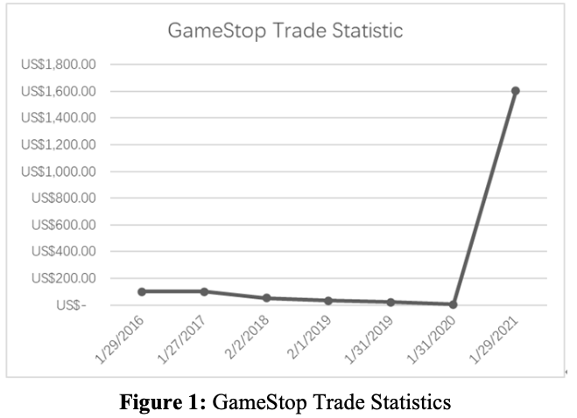
TRADE STATISTICS

Slide 6
SWOT ANALYSIS
SWOT Analysis is a strategic planning tool used to evaluate the Strengths, Weaknesses, Opportunities, and Threats involved in a business venture or project.
Assess internal and external factors impacting an organization's performance, identifying areas of competitive advantage and potential risks, while informing decision-making and strategic planning.
SWOT Analysis offers a holistic view of an organization's internal capabilities and external operating environment, empowering stakeholders to make informed decisions and develop strategies for long-term success.

Slide 7
STRENGTHS
•Market leadership outside the U.S.
•High customer loyalty and longer product life cycle
•Large profit margin and annual turnover
•Strong distribution channel with global retail presence
•Prestigious brand recognition and Fortune 500 ranking
•Significant position in the stock market

Slide 8
WEAKNESS
•Dependency on suppliers and risks in the supply chain
•Declining demand for brick-and-mortar stores due to online competition
•Inability to control the production process and cyclical operations
•Shorting by hedge funds impacting company performance

Slide 9
OPPORTUNITIES
•Increased gaming market due to COVID-19
•Enhanced reputation from 2021's Short Squeeze
•Innovation in business model and focus on Trade-in model
•Transition to online approach and customer-focused technology company

Slide 10

THREATS
•Supply chain instability caused by COVID-19
•Fierce competition from established game retailers
•Economic, social, and political factors affecting demand
•Volatility in stock market due to various factors including short squeezes

Slide 11

Conclusion for SWOT Analysis
Strategic Advantages: GameStop's global market leadership, loyal customer base, and extensive distribution network, alongside its recognized brand and strong stock market presence, cement its competitive edge and industry dominance.
Challenges and Adaptation: GameStop confronts supplier dependencies, declining physical store demand, and hedge fund pressures. Yet, opportunities for innovation, like online transition and trade-in focus, offer avenues for growth and resilience.
Navigating Uncertainty: Despite supply chain disruptions, fierce competition, and economic volatility, GameStop's strategic positioning enables it to seize opportunities and mitigate risks, ensuring long-term viability and market resilience.

Slide 12
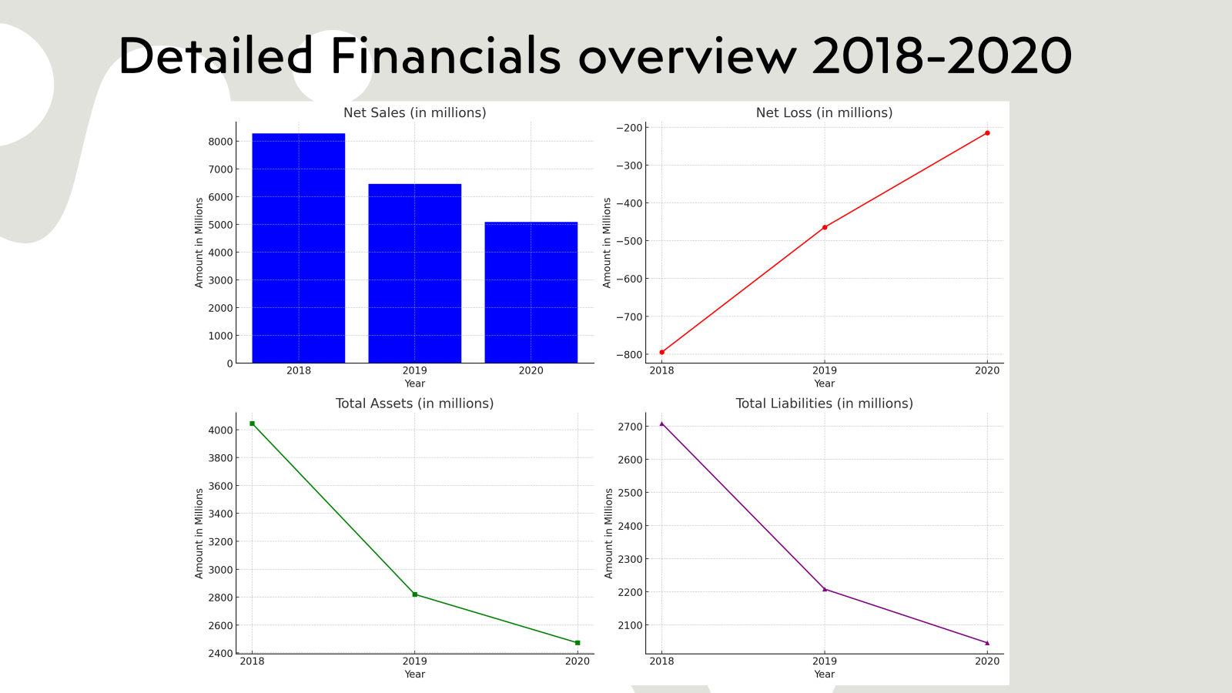

Slide 13
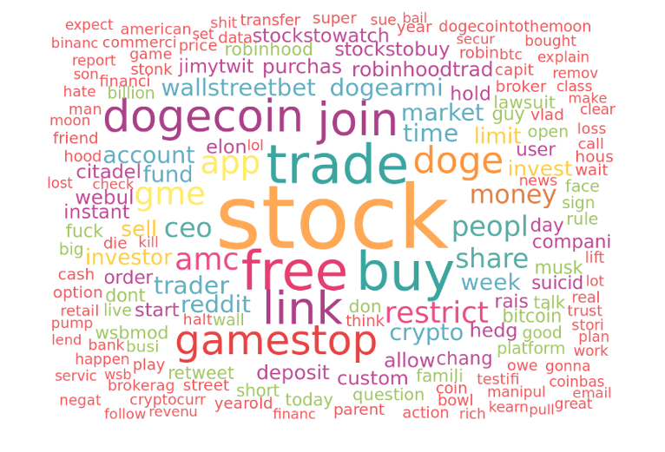
Word cloud of most frequent words(Before Phase)​
This visualization displays a mix of both positive and negative terms, with significant representation of words such as "disappointed" and "happy," suggesting a diverse range of sentiments within the data.

Slide 14
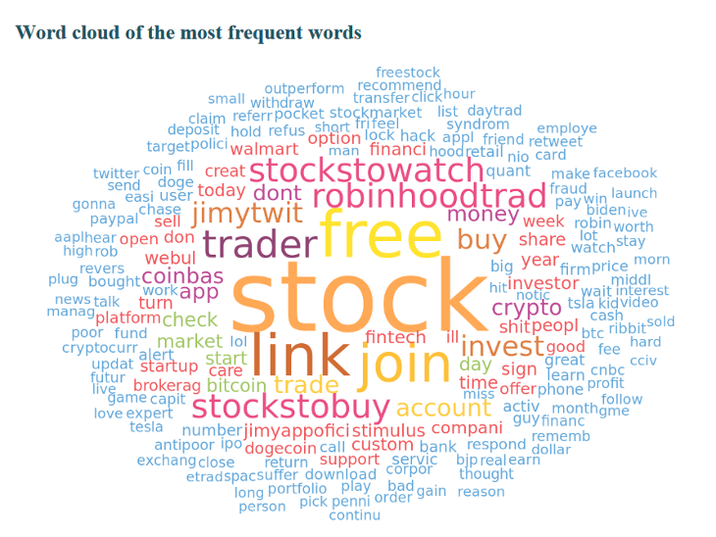
Word cloud of most frequent words(During Phase)
This word cloud highlights key terms predominantly associated with positive emotions, with words like "enjoy" and "satisfied" appearing prominently, reflecting a generally positive sentiment in the dataset.

Slide 15
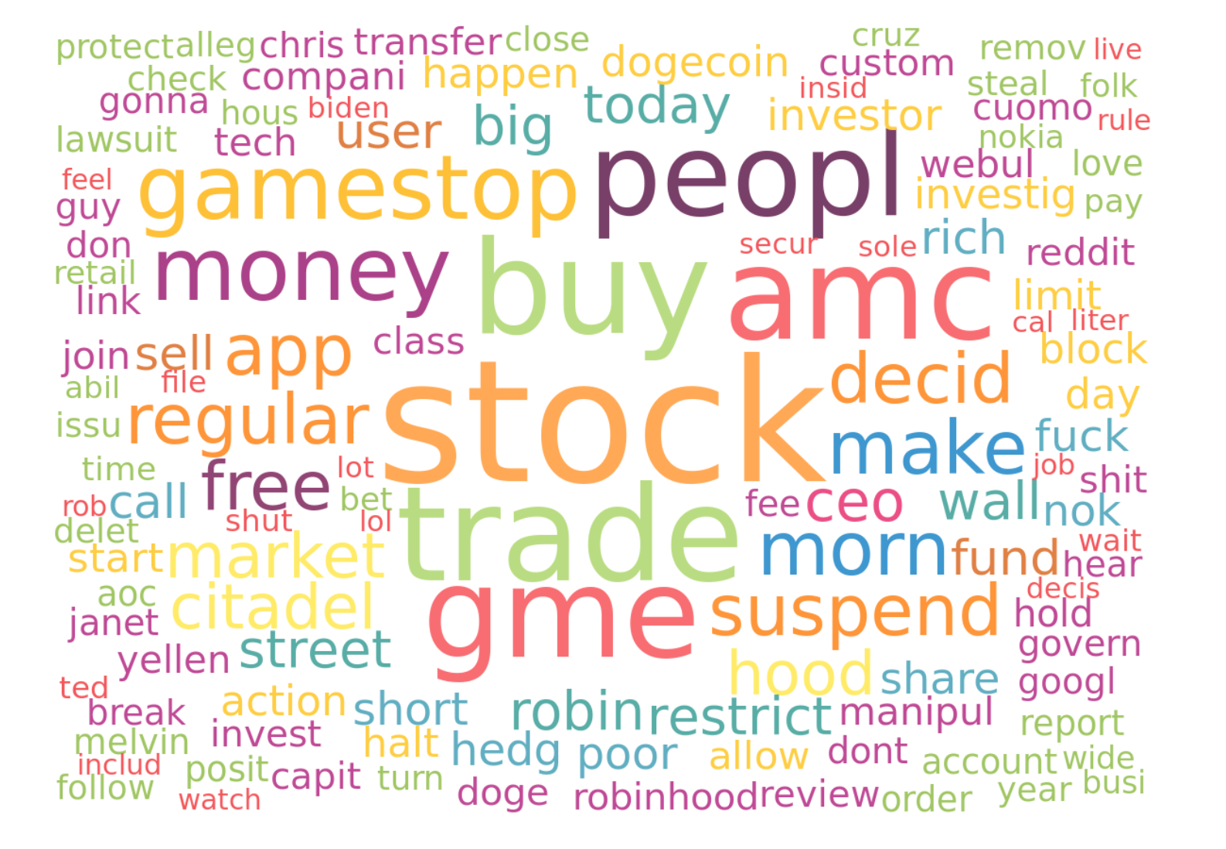
Word cloud of most frequent words(After Phase)​​
This word cloud displays emotions such as anger, anticipation, and trust are highlighted. Each word's size corresponds to its frequency in a dataset of 4,997 rows, offering insights into the collective emotional response captured."

Slide 16

Common Characteristics & Limitations
Common Characteristics:
All three results employ a large list of default stop words (851 words) and custom stop words, which suggests that common and less meaningful words (like "and", "the", etc.) are omitted to focus on more significant terms relevant to sentiment analysis.
Each word cloud is generated from a corpus of approximately 4,999 entries, ensuring a robust sample size for analysis
Limitations:
Word clouds provide a quick visual impression but lack depth in terms of context and sentiment intensity. They show what is being talked about, not how it's being discussed. It's like hearing a lot of noise without knowing what the conversation is about.
Similar terms not combined due to the lack of stemming might cause important themes to be underrepresented visually.
Ex:Imagine you have a pile of apples, oranges, and bananas but you count red and green apples separately. If you do this, it might look like you have fewer apples than oranges, even if you actually have more apples when you count both red and green ones together. This is what happens when similar words (like "run" and "running") are counted separately in a word cloud because they're not "stemmed" to their root form (like just "run"). So, you might not see the full picture of which themes are truly most talked about.

Slide 17

Summarizing the insights from the word clouds, sentiment ​analysis, emotion analysis, and parts-of-speech tags from the Twitter ​data obtained in the “during” phase of the GameStop debacle ​
​
The insights from the word clouds during the peak of the GameStop incident likely reveal a high frequency of terms associated with trading activity (like "buy," "sell," "stock"), expressions of sentiment ("profit," "loss," "angry," "excited"), and specific references to entities involved ("GameStop," "Robinhood," "Reddit").
Sentiment analysis would likely show a high volume of negative sentiment due to user frustration with trading restrictions.
Emotion analysis might indicate heightened emotions such as anger and trust issues, while parts-of-speech tags would highlight the dominance of verbs related to trading actions and adjectives reflecting sentiment.

Slide 18
Comparing insights with we got from similar analyses of the data from the “before” and “after” phases...
Comparing insights from the "during" phase with "before" and "after," we might notice a shift in sentiment; prior to the incident, the discussion could have been more neutral or positive, focusing on trading opportunities.
Afterward, sentiment might shift towards a more critical tone regarding trust and the financial system.
The parts-of-speech could shift from action-oriented verbs to more emotive and reflective language as discussions move from trading strategies to reactions and reflections on the incident's impact.

Slide 19
Recommendations for Robinhood to address the issues raised by the GameStop debacle
Transparent communication about trade restrictions to restore trust.
Educational initiatives explaining market mechanics and risks, particularly addressing misinformation and panic induced by high volatility.
Product feature adjustments to better inform users about potential risks and the status of their trades, aiming to empower users with knowledge and control.
These recommendations are made to address the loss of trust and to counteract the perception that Robinhood does not have its users' best interests at heart, as well as to prevent future crises through better-informed user decisions.

Slide 20
Characterizing conversations about Robinhood on Twitter during the three phases, “Before,” “During,” and “After”
The conversation themes around Robinhood on Twitter in the three phases likely evolved from discussions on market opportunities ("Before") to reactions to the trading restrictions ("During") and debates on market fairness and the role of retail investors in the stock market ("After").
At the Congressional hearing, Robinhood should focus on clarifying its decision-making process, its commitment to democratizing finance, and measures to prevent future incidents.

Slide 21

Strategic Approaches for Robinhood: Navigating Current Challenges and Sentiment Analysis Insights
A multi-faceted strategy would be most appropriate for Robinhood:
Proactively engage in an advertising/PR campaign emphasizing its core mission, transparency, and customer support improvements to address the perception problem.
Concurrently, implement app changes to add safety features and more in-depth educational resources, taking a proactive stance to demonstrate commitment to user well-being and market integrity.
"Wait and watch" could be a part of their strategy, but not in isolation. Observing market and regulatory responses is crucial for making informed decisions moving forward.
Robinhood should communicate its efforts to improve trading practices and app features, showing they are taking steps to ensure a more responsible trading environment.

Slide 22
Questions..?
Have you made any investments?
Is there any sudden rise in value? If yes, what could be the reasons behind that?
What is your overall experience with that?

Slide 23
Any questions...?
Thank you

